Slide 1

PCSE214- MOBILE APPLICATION DEVELOPMENT
CHAPTER I
INTRODUCTION TO ANDROID
By: Mr. Tobias
Professional Certificate in Software Engineering

Slide 2
OBJECTIVES
Understand basic android programming
Perks of using android
Features of any market worthy android app
Set up an android programming environment
Create Your First Application
Design android user interfaces

Slide 3
Android - Overview
Android is an open-source and Linux-based operating system designed for mobile devices, such as smartphones and tablet computers. It was developed by the Open Handset Alliance, led by Google and other companies.
Android offers a unified approach to mobile application development. This means that developers only need to develop for Android, and their applications should be able to run on different devices powered by the Android operating system.

Slide 4
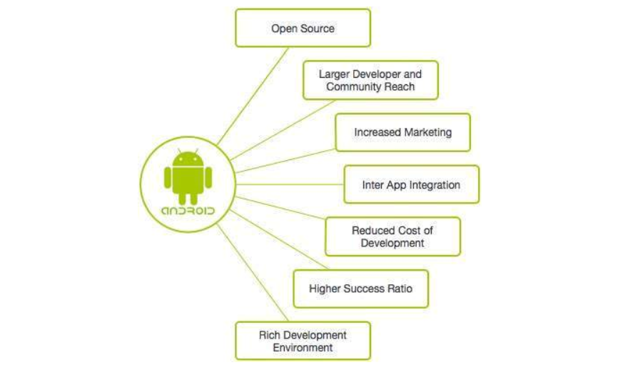
Why Android ?

Slide 5
Features of Android – Minimum Requirements
Android is a powerful operating system built with certain pre-set and expected features below:
Beautiful UI
Connectivity
Storage
Media support
Messaging
Multi-tasking
Resizable widgets

Slide 6

Beautiful UI
Android OS basic screen provides a beautiful and intuitive user interface.

Slide 7
Storage
Android apps possess the unique ability to store data and be able to query said data. Databases like;
SQLite
MySQL
MSSQL SERVER
Firebase

Slide 8
Multi Tasking
User can jump from one task to another and same time various application can run simultaneously.

Slide 9
Resizable Widgets
Widgets are resizable, so users can expand them to show more content or shrink them to save space.
NOTE: A widget is a small gadget or control of your android application placed on the home screen. Widgets can be very handy as they allow you to put your favourite applications on your home screen in order to quickly access them. You have probably seen some common widgets, such as music widget, weather widget, clock widget etc.

Slide 10
Android Development Environment
Android Studio is the official integrated development environment for Google's Android operating system, built on JetBrains' IntelliJ IDEA software and designed specifically for Android development.

Slide 11
Android Development Environment – Set Up
System Requirements
Before downloading and installing Android Studio, the following requirements are essential.
Operating System Version - Microsoft Windows 7/8/10 (32-bit or 64-bit).
Random Access Memory (RAM) - Minimum 4 GB RAM and 8 GB RAM recommended.
Free Disk Space - Minimum 2 GB and 4 GB recommended.
Minimum Required JDK Version - Java Development Kit (JDK) 8.
Minimum Screen Resolution - 1280 * 800.resolution

Slide 12
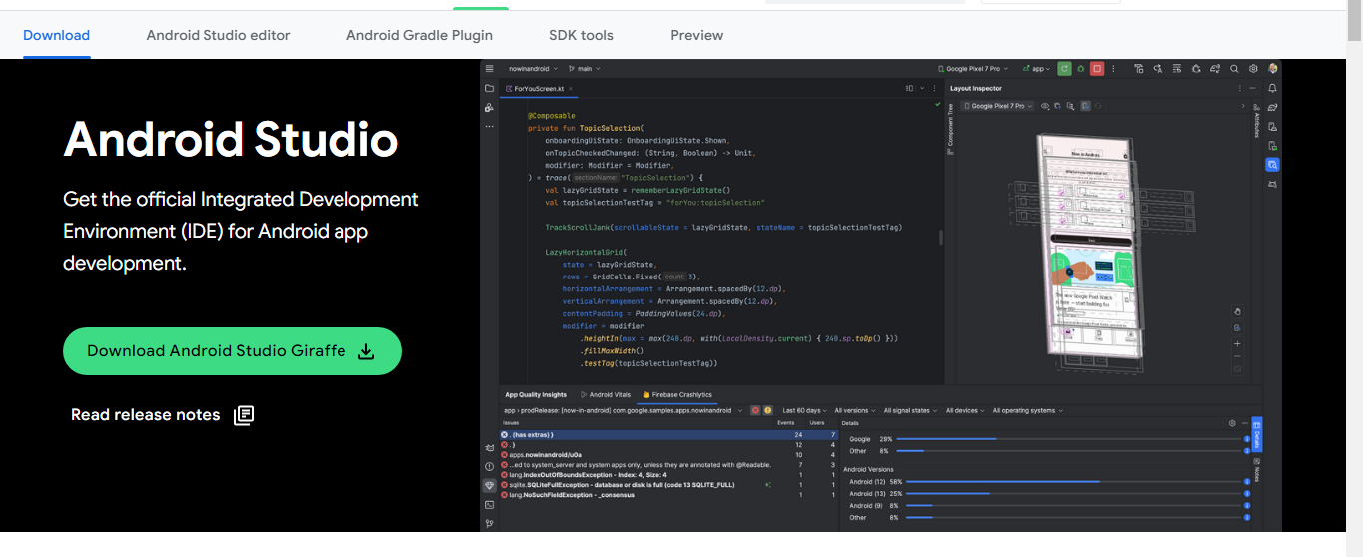
Android Development Environment – Set Up
Step 1
To download the Android Studio, visit the official Android Studio https://developer.android.com/studio?gclid=EAIaIQobChMIuNfGnbKVgQMV241oCR3quwkWEAAYASAAEgKkZ_D_BwE&gclsrc=aw.ds) website in your web browser.
Step 2
Click on the "Download Android Studio Giraffe" option.

Slide 13
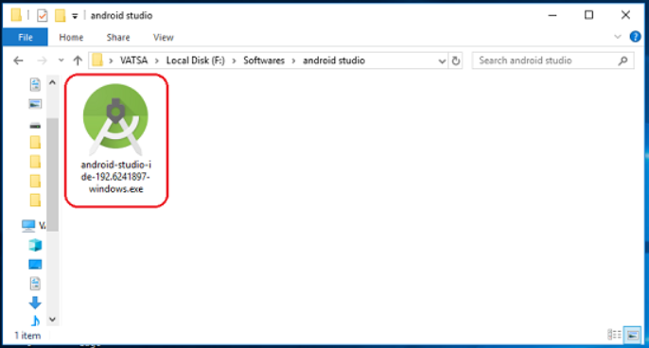
Android Development Environment – Set Up
Step 3
Double click on the downloaded "Android Studio-ide.exe" file.

Slide 14
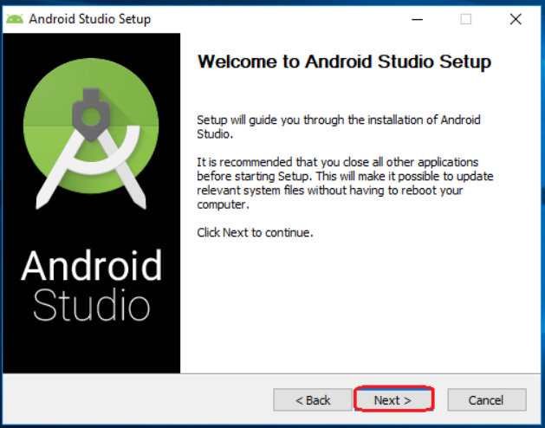
Android Development Environment – Set Up
Step 4
"Android Studio Setup" will appear on the screen and click "Next" to proceed.
.

Slide 15
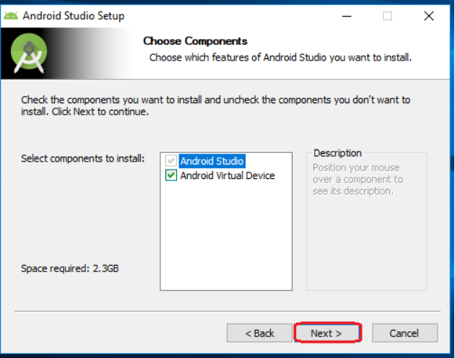
Android Development Environment – Set Up
Step 5
Select the components that you want to install and click on the "Next" button.

Slide 16
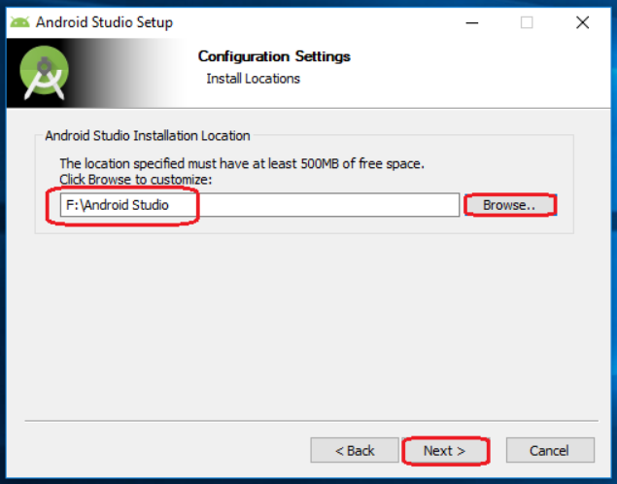
Android Development Environment – Set Up
Step 6
Now, browse the location where you want to install the Android Studio and click "Next" to proceed.

Slide 17
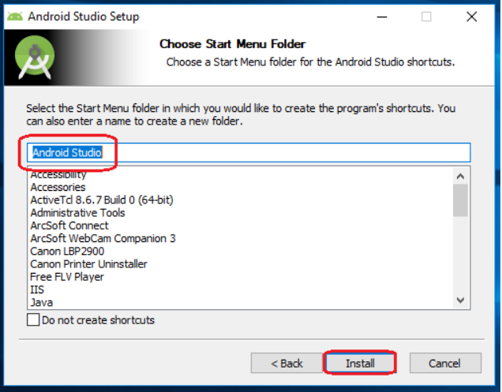
Android Development Environment – Set Up
Step 7
Choose a start menu folder for the "Android Studio" shortcut and click the "Install" button to proceed.

Slide 18
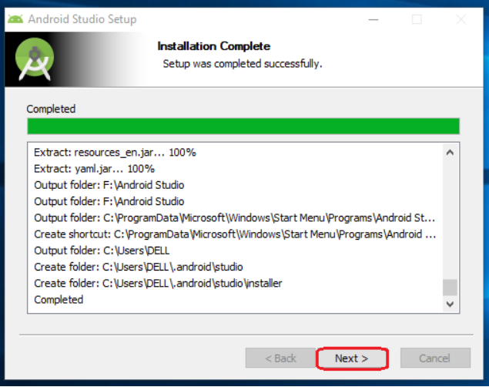
Android Development Environment – Set Up
Step 8
After the successful completion of the installation, click on the "Next" button.

Slide 19
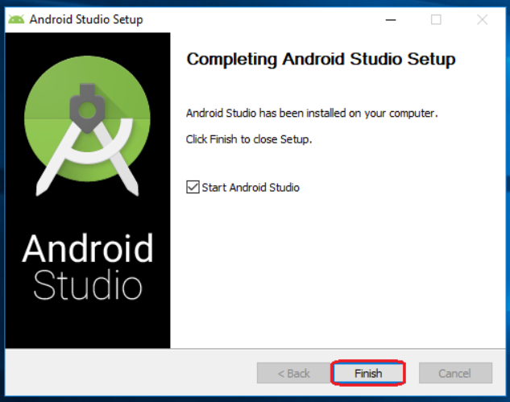
Android Development Environment – Set Up
Step 9
Click on the "Finish" button to proceed.

Slide 20
Android Environment - Configuration
After successful installation of android studio, configurations are then set u to enable to IDE compile in desired format. Such configuraions include ;
Downloading the desired Android SDKs
Choosing development skin
Choosing desired API levels for application
NOTE: API Level is an integer value that uniquely identifies the framework API revision offered by a version of the Android platform.

Slide 21
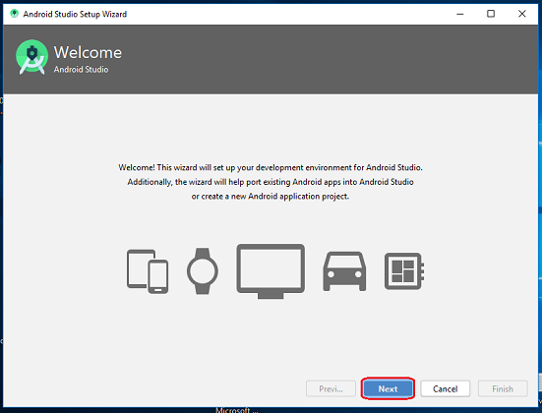
Android Development Environment – Set Up
Step 10
"Android Studio Setup Wizard" will appear on the screen with the welcome wizard. Click on the "Next" button.

Slide 22
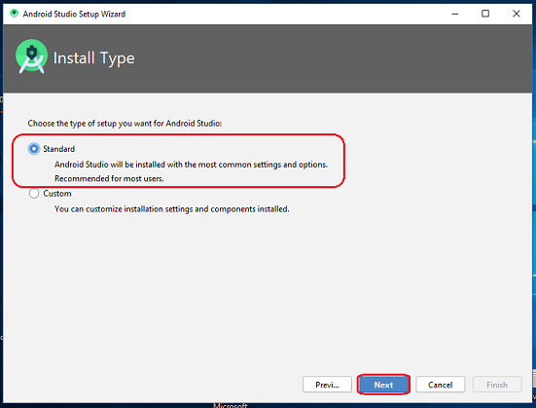
Android Development Environment – Set Up
Step 11
Select (check) the "Standard" option if you are a beginner and do not have any idea about Android Studio. It will install the most common settings and options for you. Click "Next" to proceed.

Slide 23
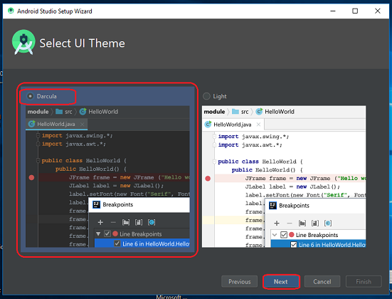
Android Development Environment – Set Up
Step 12
Now, select the user interface theme as you want. (I prefer Dark theme (Dracula) that is most liked by the coders). Then, click on the "Next" button.

Slide 24
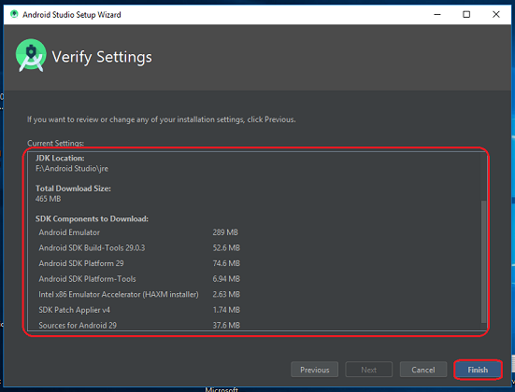
Android Development Environment – Set Up
Step 13
Now, click on the "Finish" button to download all the SDK components.

Slide 25
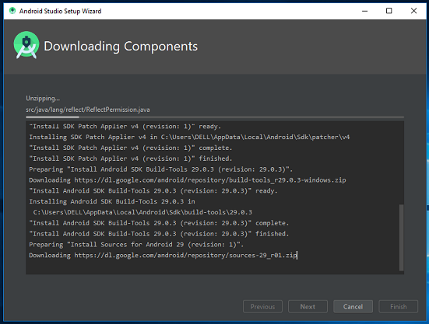
Android Development Environment – Set Up
Step 13
Now, click on the "Finish" button to download all the SDK components.

Slide 26
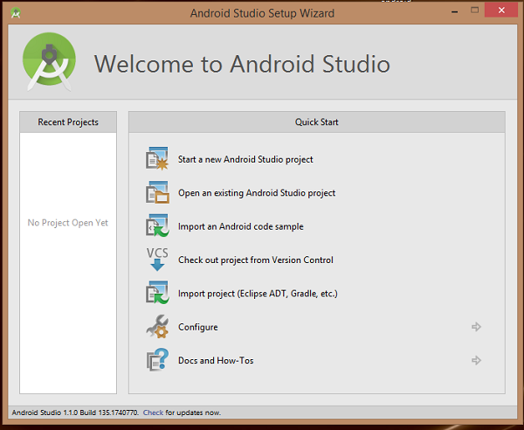
Hello World
After successful installation of Android Studio. Open it and select Start a new project.

Slide 27
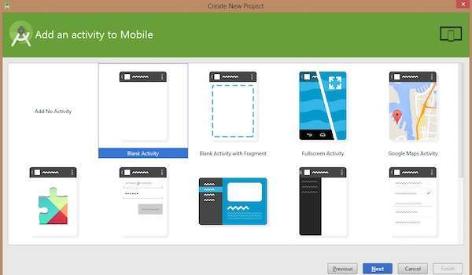
Hello World
Proceed to select the activity of your choice of your first application

Slide 28
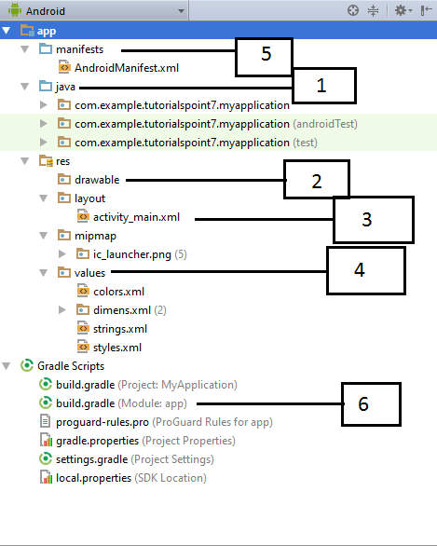
Anatomy of Android Application
Before you run your app, you should be aware of a few directories and files in the Android project

Slide 29
Directories - Defined
Java
This contains the .java source files for your project. By default, it includes an MainActivity.java source file having an activity class that runs when your app is launched using the app icon.
res/drawable-hdpi
This is a directory for drawable objects that are designed for high-density screens.
res/layout
This is a directory for files that define your app's user interface.

Slide 30
Directories – Defined Contd…
res/values
This is a directory for other various XML files that contain a collection of resources, such as strings and colours definitions.
AndroidManifest.xml
This is the manifest file which describes the fundamental characteristics of the app and defines each of its components.
Build.gradle
This is an auto generated file which contains compileSdkVersion, buildToolsVersion, applicationId, minSdkVersion, targetSdkVersion, versionCode and versionName

Slide 31
Overview of Android Files
The Main Activity File
The main activity code is a Java file MainActivity.java. This is the actual application file which ultimately gets converted to a Dalvik executable and runs your application. Following is the default code generated by the application wizard for Hello World! application

Slide 32
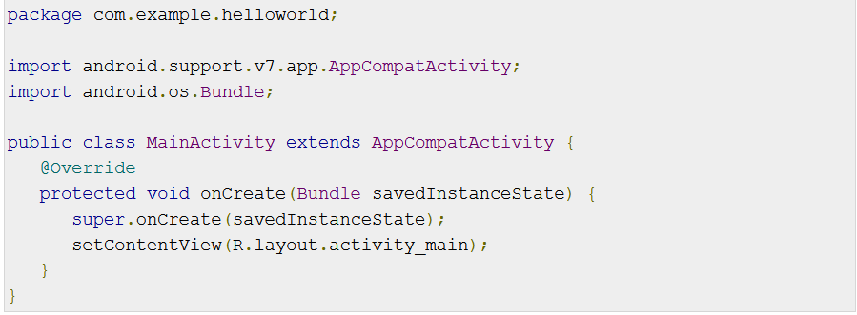
Snippet
Here, R.layout.activity_main refers to the activity_main.xml file located in the res/layout folder. The onCreate() method is one of many methods that are figured when an activity is loaded.

Slide 33
Overview of Android Files Contd…
The Manifest File
Whatever component you develop as a part of your application, you must declare all its components in a manifest.xml which resides at the root of the application project directory. This file works as an interface between Android OS and your application, so if you do not declare your component in this file, then it will not be considered by the OS. For example, a default manifest file will look like as following file −

Slide 34
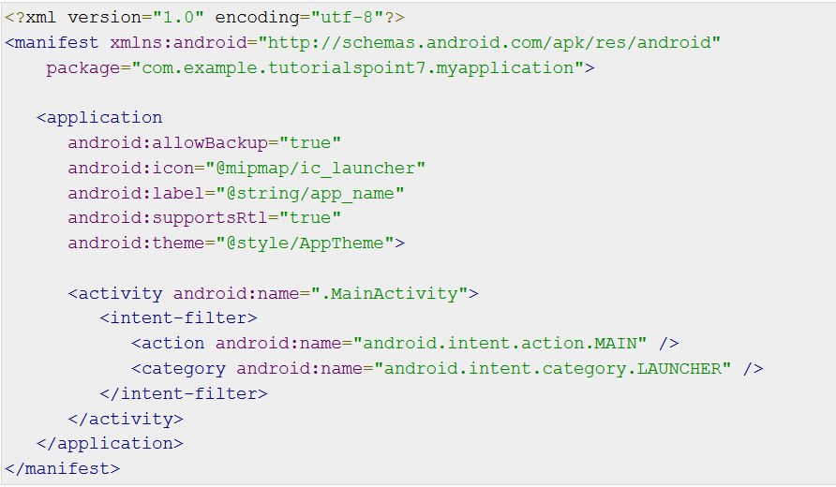
Snippet

Slide 35
Description
Here <application>...</application> tags enclosed the components related to the application. Attribute android:icon will point to the application icon available under res/drawable-hdpi.
The application uses the image named ic_launcher.png located in the drawable folders
The <activity> tag is used to specify an activity and android:name attribute specifies the fully qualified class name of the Activity subclass and the android:label attributes specifies a string to use as the label for the activity.
You can specify multiple activities using <activity> tags.
The action for the intent filter is named android.intent.action.MAIN to indicate that this activity serves as the entry point for the application. The category for the intent-filter is named android.intent.category.LAUNCHER to indicate that the application can be launched from the device's launcher icon.
The @string refers to the strings.xml file explained below. Hence, @string/app_name refers to the app_name string defined in the strings.xml file, which is "HelloWorld". Similar way, other strings get populated in the application.

Slide 36
Description Contd…
Following is the list of tags which you will use in your manifest file to specify different Android application components −
<activity>elements for activities
<service> elements for services
<receiver> elements for broadcast receivers
<provider> elements for content providers

Slide 37
Overview of Android Files Contd…
The Strings File
The strings.xml file is located in the res/values folder and it contains all the text that your application uses. For example, the names of buttons, labels, default text, and similar types of strings go into this file. This file is responsible for their textual content. For example, a default strings file will look like as following file −

Slide 38
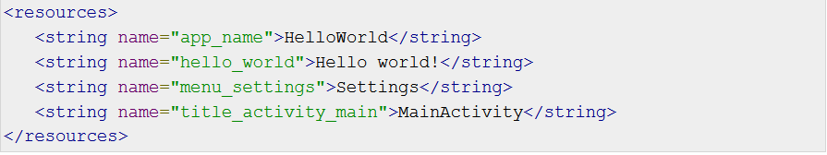
Snippet

Slide 39
Overview of Android Files Contd…
The Layout File
The activity_main.xml is a layout file available in res/layout directory, that is referenced by your application when building its interface. You will modify this file very frequently to change the layout of your application. For your "Hello World!" application, this file will have following content related to default layout −

Slide 40
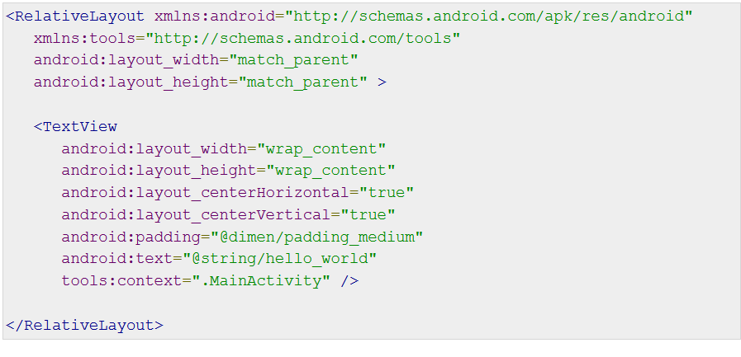
Snippet

Slide 41
Snippet - Explained
This is an example of simple RelativeLayout which we will study in a separate chapter. The TextView is an Android control used to build the GUI and it have various attributes like android:layout_width, android:layout_height etc which are being used to set its width and height etc.. The @string refers to the strings.xml file located in the res/values folder. Hence, @string/hello_world refers to the hello string defined in the strings.xml file, which is "Hello World!".

